Slide 1
Memory Management
Introduction
-Cherry Khosla

Slide 2
Introduction
Memory management is one of the most important functions of an operating system. The working of a computer system majorly depends on two components: Memory and CPU.
As far as the memory of a system is concerned there are three important criteria which an operating system has to take care.
  Size- More the memory is available more it is easy to solve complex problems.
  Access time- Less access time is desirable to execute the programs.
  Per unit Cost-Per unit cost of the memory should be less.

Slide 3
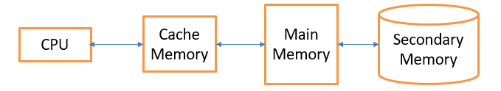
Why we need memory Hierarchy
Memory hierarchy of the system manages to fulfil the above-mentioned criteria with the help of a concept called locality of reference.

Slide 4
Role of OS in managing Memory
Operating system basically deals with main memory and secondary
memory. With respect to this, there are two important responsibilities of an operating system.
  Space Allocation- Operating system will decide which process will get
  which area in the main memory.
  Address Translation- Conversion of the logical address generated by
  CPU to the physical address of the main memory.

Slide 5
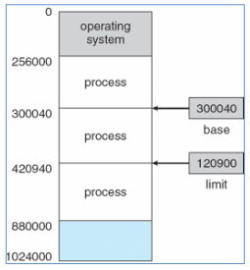
Protection of user space
Main memory is effectively divided into two partitions- one partition is reserved for operating system, while other is available for user processes.
Protection of user's address space is done with the help of two different registers built onto the processor: base register and limit register.
Base Register: Specifies the smallest legal physical memory address
Limit Register: Specifies the size of the range.

